Slide 1
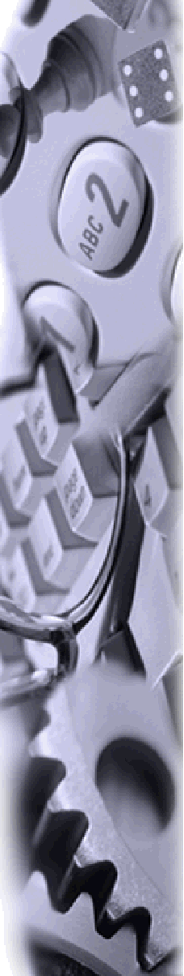
THE MIDDLE OFFICE
A PERSONAL VIEW

Slide 2
THE MIDDLE OFFICE
It is…
Where we are in the organisation
Who we are
What we do
How we operate
Essential for managing operational risk

Slide 3
WHERE ARE WE ?
The Middle Office sits in the centre of the full regular business process:-
Flow of business information
COMMERCIAL
Traders
Originators
Marketers
Logistics (Global)
MIDDLE OFFICE
Risk Management
Documentation
Settlements &
Trade Accounting
Coordination (Global)
RAC - Credit & Market Risk
CORPORATE OFFICE
FIN OPS/TAX
LEGAL
TRANSACTION MANAGEMENT
INFORMATION TECHNOLOGY

Slide 4
WHO ARE WE?
Staff in the Middle Office are dedicated support professionals who...
understand trading and operational risks from business activities
provide complete, accurate & relevant business information (DPR, confirmations, invoices & entity accounts)
have responsibility for routine/regular communication with Commercial
have responsibility for data within Enron’s risk, settlement, accounting & corporate systems
We also have the ‘thickest’ skins in the organisation!

Slide 5
WHAT WE DO
Specifically we…
support the execution of risk within the transactions that Commercial complete
capture, enhance, validate and control data for those transactions
revalidate, measure, report and control the historical portfolio of transactions
ensure that the performance of the transactions is as expected - invoicing and authorising cash realisation
book the economic performance into our accounting systems
In summary we …
have prime responsibility for the day to day control environment
own the end to end transaction process
are best placed to co-ordinate the implementation of system enhancements

Slide 6
HOW WE OPERATE
Historically we have …
specialised in product/business groups
duplicated specialist functional skills within the product/business silos
suffered from IT resource reallocation away from the development of an effective and scaleable trading system architecture
what IT solutions we have developed are based upon the individual business’s appetite for a level of operational risk, or
suffered manual processes where the assessment of operational risk has been low (or incomplete)
invested enormous energy & effort in supporting the business in it’s growing pains (which the business appreciates!)

Slide 7
MANAGING CURRENT &
FUTURE OPERATIONAL RISK
I believe we have not...
always sufficiently escalated trends in operational risk - highlighting where business/volume growth becomes incompatible with existing system/processes/resources
taken sufficient accountability for I.T. initiatives or automation of control processes
identified/implemented sufficient scaleability/efficiency in existing processes
identified cross product businesses synergies by function (e.g. within risk management, documentation, trade accounting & settlements)
anticipated how critical succession planning is, in that it allows mobility of staff both within Middle Office and outside it

Slide 8
MANAGING CURRENT &
FUTURE OPERATIONAL RISK
The impact of the above is…
duplication of effort between groups within business (eg. settlements & trading accounting
different control standards across businesses
delayed IT projects
too much manual work and a patchwork applications architecture
low rotation rate of staff within the Middle Office

Slide 9
HOW CAN WE IMPROVE?
We need to continuously challenge our current processes, structure and resources. I would like to improve…
the systems we have
- by making ourselves accountable for I.T. delivery
- by ‘ring-fencing’ IT resources to our priority developments
our assessment of what risk we are managing
- by being self-critical, identifying concerns and control gaps and escalating to management what we need to fix it the problems
the sharing of best practices/ideas
- by breaking down ‘barriers’ between all groups and businesses

Slide 10
HOW CAN WE IMPROVE?
I would like to improve...
the understanding of the impact we have on Enron staff ‘downstream’ (FIN OPS, Tax, RAC, Houston Corporate office)
- by training/education and defining ‘hand-off’s to other groups
our people management
- by focusing on the right amount of recruitment, rotation and consequently retention (in MO)
morale
- by doing all of the above and ensuring the business understands the ‘value’ we add to Enron

Slide 11
WHAT IS OUR NEXT STEP?
everyone should push back where they are uncertain about what I have said
‘Buy-in’ to the vision of the Middle Office and our aim
understand this is an evolution not revolution
go to the pub!

